Slide 1


Slide 2
Forces Supporting & Resisting Changes in Organisations
FORCES FOR STATUS QUO
(Constraints)
FORCES FOR CHANGE
(Enablers)
Management Buffer
Social Resistance
Habit/ Fear of Loss of Power & status/ Friendship Networks/ Dependence/ Uncertainty
Economic Reasons
Organisational Resistance/Structure, Rules & Procedures/ Interorganisational Agreements/Sunk Costs/Limited Resources
New Technology
Changing Work Values
Knowledge Explosion
Product Obsolescence
Industry Competition
Market Turbulence

Slide 3
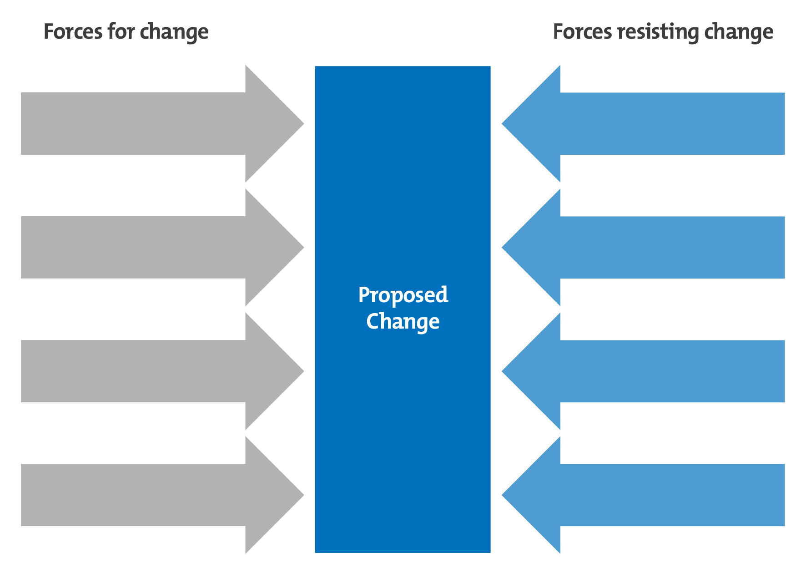
Force Field Analysis – Kurt Lewin
In 1947 Lewin introduced the interesting and valuable technique of FORCE FIELD ANALYIS – a change management technique.
He argued that the nature & pace of change depend on the balance of driving and restraining forces in relation to a particular change , or “target” situation”
DEFINITION
  Force Field Analysis is a technique for assessing the factors that encourage & the factors that resist movement towards a desired target situation, thus allowing an assessment of the viability of the change, & suggesting action to alter the balance of forces, if necessary.

Slide 4
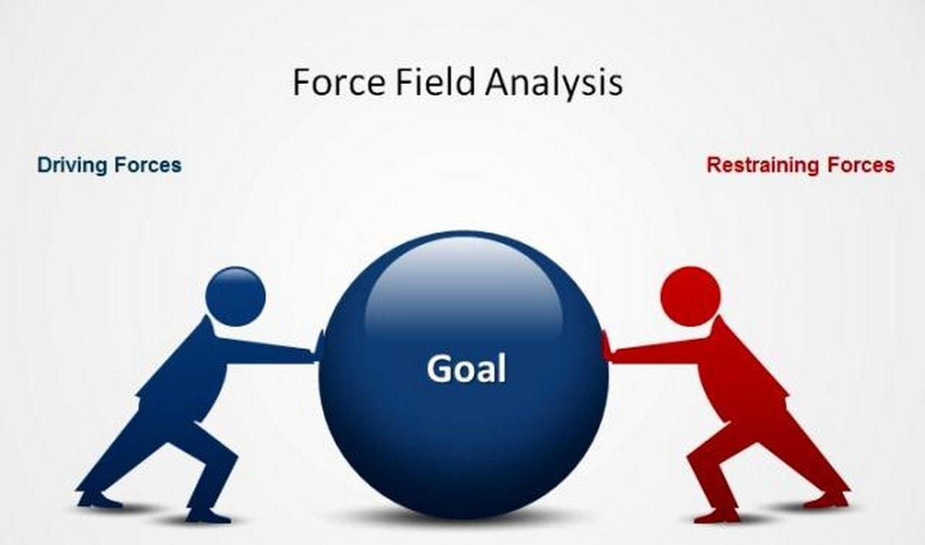
Force Field Analysis – Kurt Lewin
A typical force field analysis could look like this:
DRIVING FORCES RESTRAINING FORCES
Friendly natives Family in UK
Inexpensive lifestyle High cost of moving
The wide open spaces The long journey to anywhere
The beer, the wine The mosquitoes, the spiders
Clear skies, sunshine, beaches Sunburn, skin cancer, sharks
A Force Field Analysis involves identifying the factors or forces supporting and impeding movement towards a given target situation. The forces can be weighted to give a rough guide to the balance of forces.

Slide 5
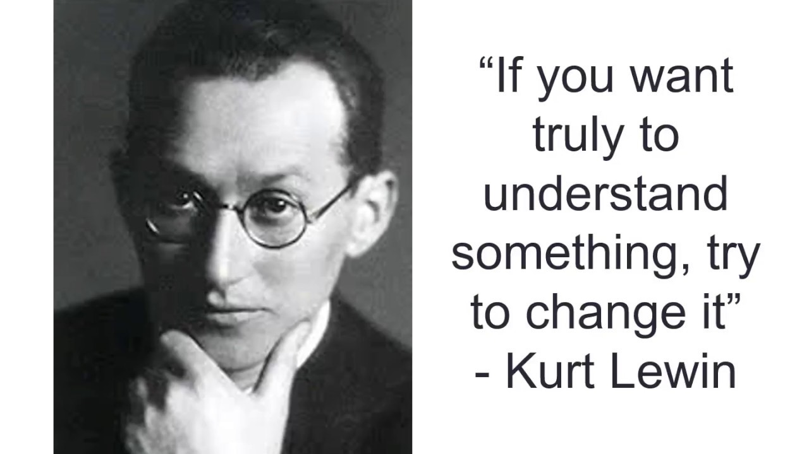

Kurt Lewin
Kurt Lewin considered organisational change to have 3 main elements:
Unfreezing Transition Refreezing
Unfreezing the current The transition into the Refreezing or stabilising
state of affairs new state / Change the changes to make
(attitudes, beliefs, values) to the new behavior them permanent.

Slide 6
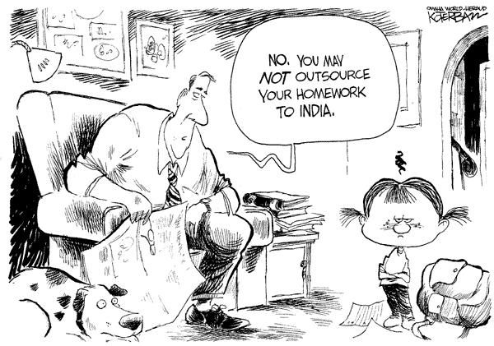
GOOD NEWS!!!
Here is some homework for you....

Slide 7


Read up on
Difficulties & Messes
1st & 2nd Order Changes

Slide 8

Personal Management Institute © 2001

Slide 9
The Organisational Iceberg
Formal (overt) aspects
Goals, Technology,
Structure, Policies &
Procedures, Products,
Financial resources
Informal (covert) aspects
Beliefs & assumptions about the formal & informal systems
Perceptions, Attittudes, Feelings (anger, fear, liking, despair about the formal & informal systems
Values
Informal interactions
Group norms

Slide 10
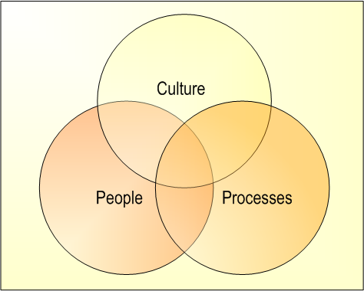

Impact of Change

Slide 11
